Slide 1
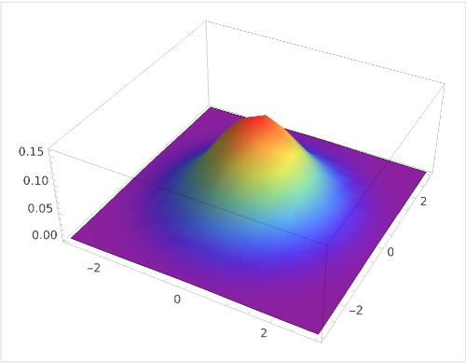
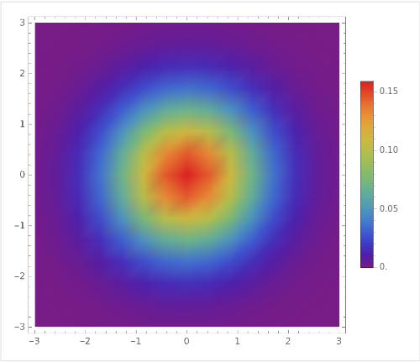
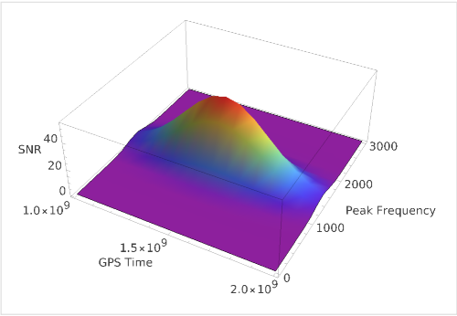
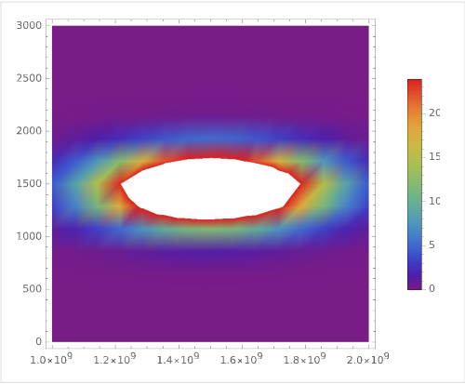


Fig I A
Fig I B
$$dr_{1}=r_{1outer}−r_{1inner}$$
Sample 3D Gaussian Plot
2D Gaussian Projection
Fig II A
Fig II B
$$dr_{2}=r_{2outer}−r_{2inner}$$
Sample 3D GW ASD Plot
2D GW ASD Projection

